Slide 1
Ideas, Beliefs, and Culture
Emily Krysko, Erin Chioffe, Erika Albright, Sammy Winters, Joey Seliga, and Ben Resnick

Slide 2
Theme:
As time progressed, America shifted from having highly Republican ideals and beliefs to a Democratic and open-minded culture and belief system.
TRENDS:
Republican, Democratic, & Gay Rights

Slide 3
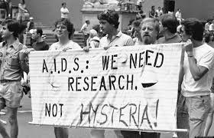
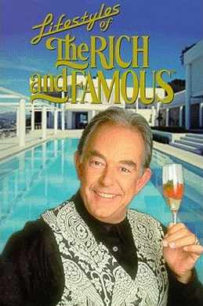
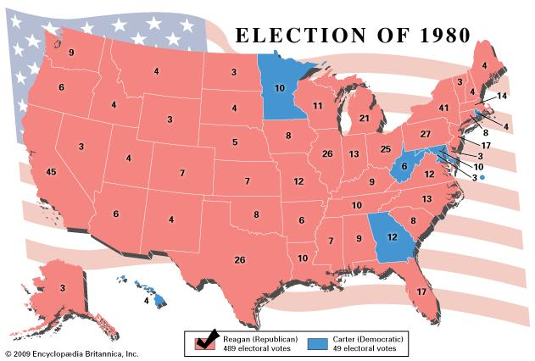
Republican

Slide 4
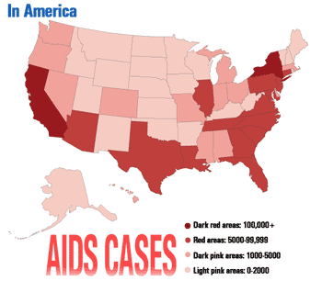
1980’s - HIV/AIDs
Origins
Enters America
1982 - Gay Related Immune Deficiency (GRID)
1982 - Acquired Immune Deficiency Syndrome (AIDS)
1984 - HTLV-III is announced as the cause

Slide 5
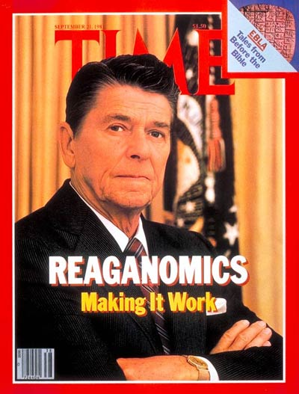
1980’s - “Rich and Famous”
TV show called “Lifestyles of the Rich and Famous” (1984-1995)
Featured extravagant lifestyles of wealthy entertainers, athletes, and business tycoons
Rich get richer
Middle class shrink
Stock market ascends rapidly
Uneven distribution of wealth
Gilded Age

Slide 6
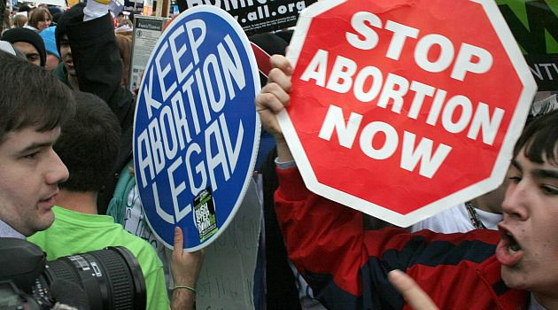
1980’s - Webster v. Reproductive Health Services
Supreme Court upheld Missouri law to restrict any state assistance to abortion
Including state funds, facilities, and employees
Viability testing at the 20th week of pregnancy
“Life begins at conception” idea
Supreme Court ruled that none of the testing was unconstitutional
Decision made by the Supreme Court allowed states to have the legislative power that was previously restricted in Roe v. Wade

Slide 7
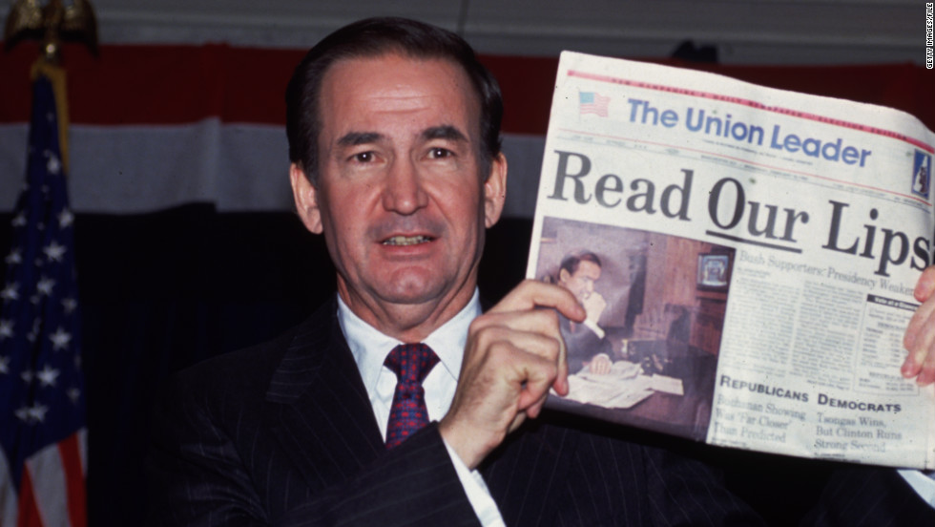
1990’s: Pat Buchanan Declares “Culture War”
Speech given at the 1992 Republican National Convention
Claimed that there was a threat to conservative/religious values in America
Severity compared to Cold War
Criticized for creating a greater “polarization” within America

Slide 8
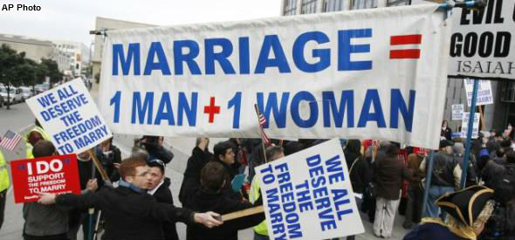
1990’s: Defense of Marriage Act
Enacted in 1998
Federal law
Defined marriage as the union between one man and one woman
Allowed states to refuse to recognize same-sex marriage
Struck down in 2013

Slide 9
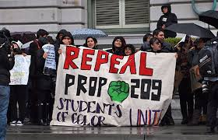
1990’s: Proposition 209 Ends Affirmative Action in California Universities
On the California general election ballot in 1996
Approved as a California constitutional amendment
Prevented public universities from discriminating based on race, sex, or ethnicity

Slide 10
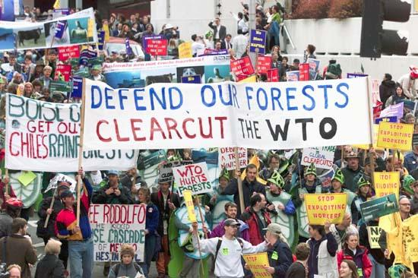
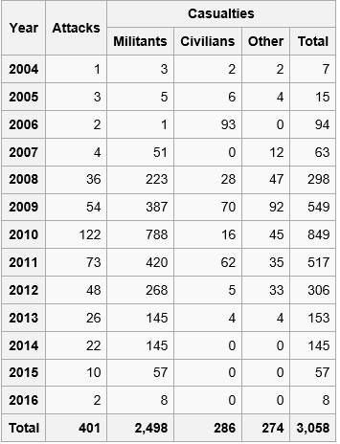
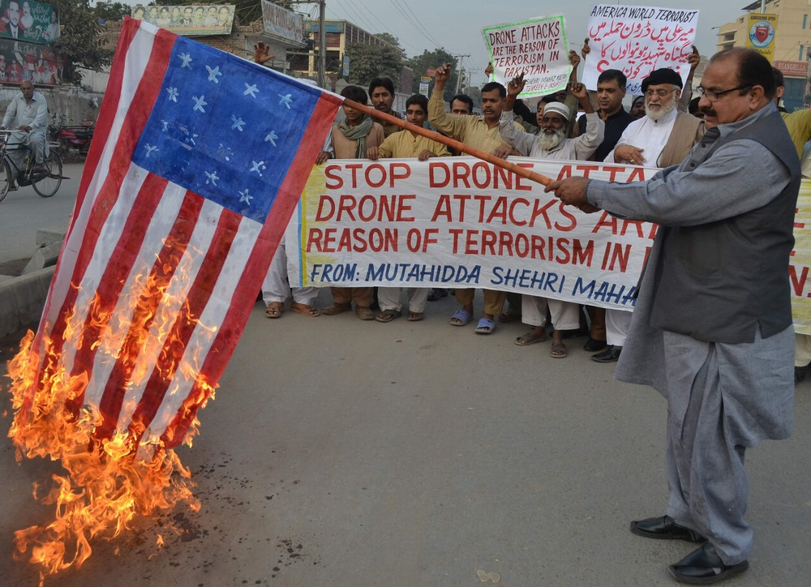
Democratic
Statistics of Drone Strikes in Pakistan

Slide 11
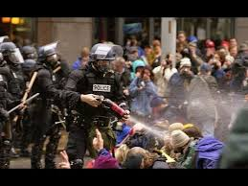
WTO Protests in Seattle
WTO- Global Organization Meeting
Discuss trade relations, rules and such
Workers' rights, sustainable economies, and environmental and social issues.
Tension rose and police open fired into the crowd
Protestors blocked entrances
Vandalism
No death or Serious Injuries

Slide 12
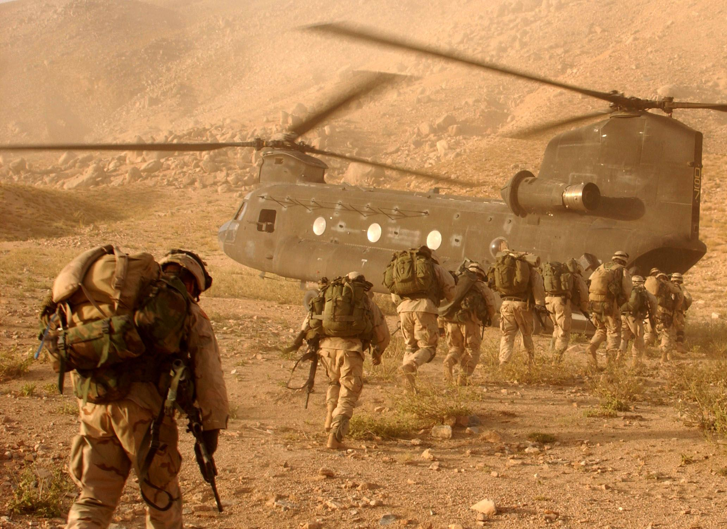
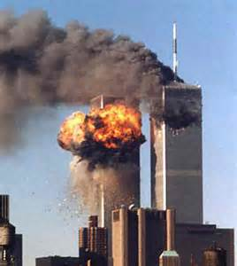
2000’s War On Terror
Trend: Democratic - outdo Republicans on national security
United States efforts to freeze assets of terrorist groups (2001-Now)
Also known as The Global War on Terrorism
Cause: 9/11
President George Bush declares in speech (9/20)
Effect: war with the middle east (Iraq and Afghanistan)
Today: U.S. moves troops to heavily terrorist areas, trying to kill leaders of terrorist groups
Tomorrow: more democratic ideals, never end

Slide 13
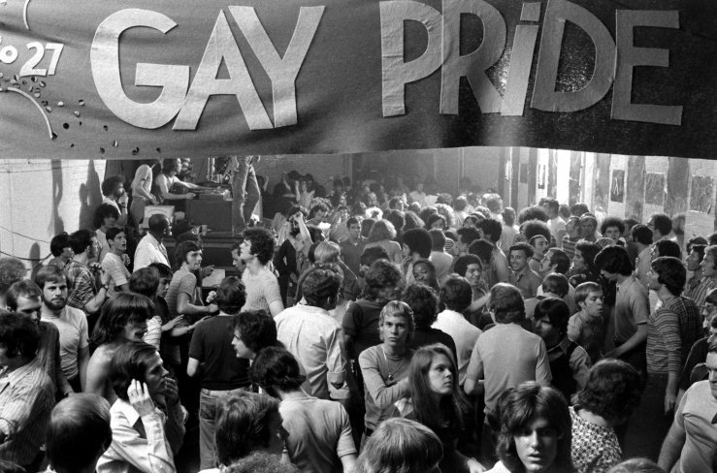
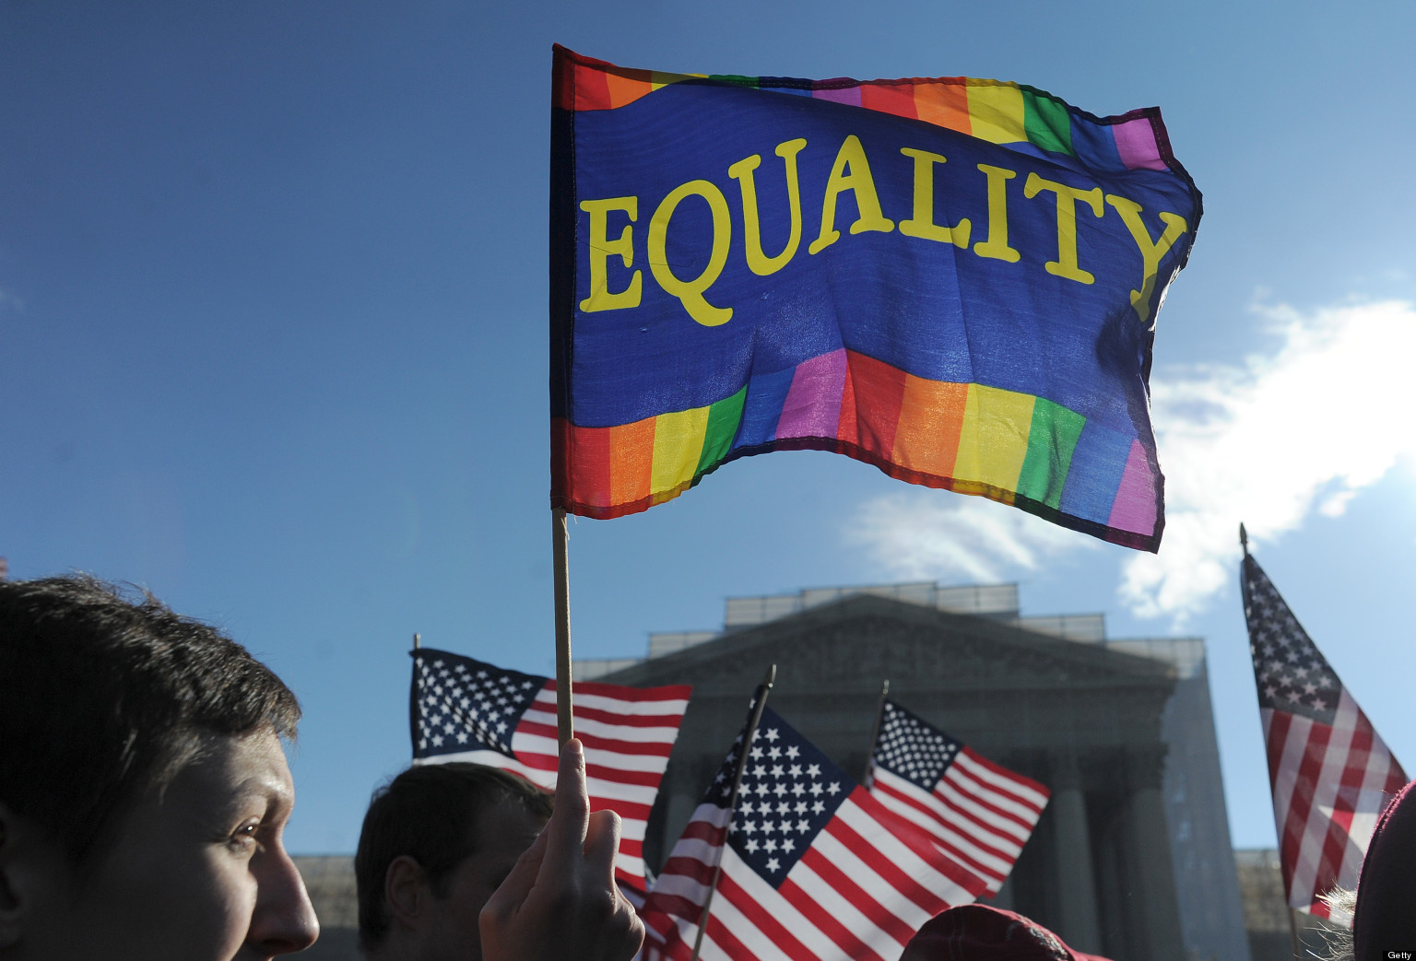
Gay Rights

Slide 14
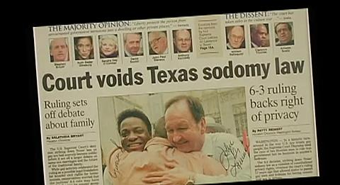
2000’s - Lawrence v. Texas
Cause: John Lawrence arrested
Effect: Supreme Court ruling
Anti-sodomy laws
Violation of privacy
Protected under the Equal Protections Clause
Today: ruling is still upheld
Tomorrow: will continue to have gay rights

Slide 15
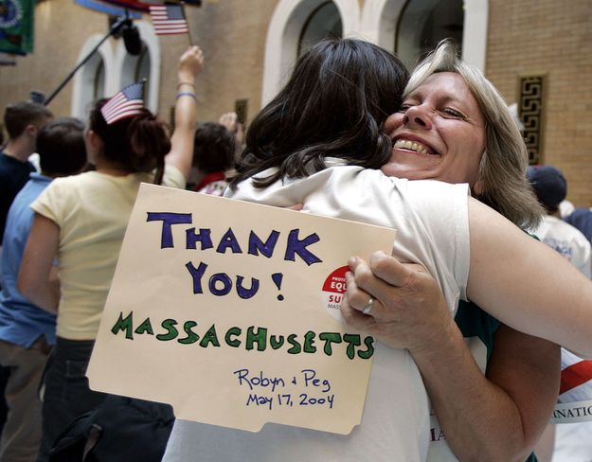
2000’s - MA Legalizes Same Sex Marriage
Cause: Goodridge vs. Department of Public Health
Appealed to the highest court
November 18th, 2003
State law found unconstitutional
Gave 180 days to change the law
Effect: May 17th, 2004
Resistance from the public
Trend: Gay Rights
Today: June 26th, 2015- legal nationwide
Tomorrow: Continuation of Gay Rights

Slide 16
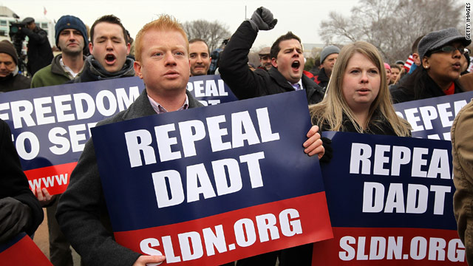
2010’s: End of “Don’t Ask, Don’t Tell” policy
Military
Distractions on the battlefield
Previously No Openly Homosexual allowed to serve
“Step Forward”-Clinton
Repealed by Obama and Congress: 2011
Initiated in 1993
Repealed 2011
Strong Push

